Slide 1
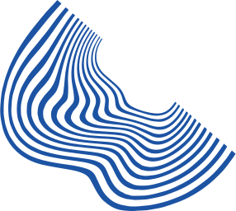

PCS-2 Project
RemoteDesk
: Seamless Remote Desktop Access and Control
Hitesh Shanmukha(B22AI013)
Ale Anwesh(B22AI005)

Slide 2

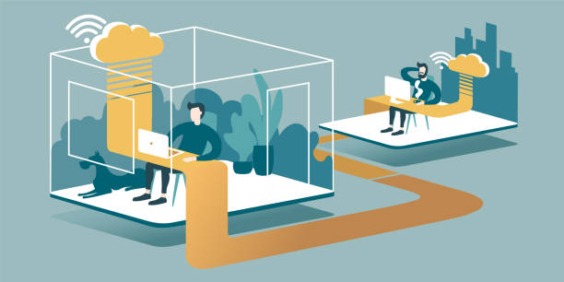
Introduction:
The Remote Desktop Application is a modern solution designed to facilitate remote access and control of desktop interfaces.
Importance of Remote Desktop Control:
Enhanced Productivity: Remote access allows users to work from anywhere, increasing productivity and flexibility.
Remote Troubleshooting: IT professionals can diagnose and resolve issues on remote computers without needing to be physically present.
Access to Resources: Remote desktop control enables users to access files, applications, and resources stored on remote computers.
Collaboration: Teams can collaborate effectively by sharing screens and working together on projects in real-time.

Slide 3

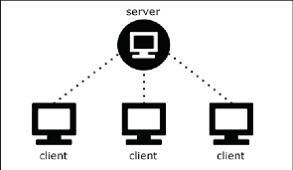
Networking Concepts
The Remote Desktop Application leverages fundamental networking concepts to enable seamless communication between the client and server components.
Socket Programming:
Socket programming forms the backbone of network communication in the application.
Sockets facilitate bidirectional communication between two endpoints over a network.
The application uses sockets to establish connections, transmit data, and handle communication between the client and server.
TCP/IP Protocol
The Transmission Control Protocol (TCP) and Internet Protocol (IP) from the TCP/IP protocol suite are utilized.
TCP ensures reliable, ordered, and error-checked delivery of data packets between the client and server.
IP handles the routing of packets across networks, enabling communication between devices connected to different networks.
Client-Server Architecture
The Remote Desktop Application follows a client-server architecture model.
In this model, the server component listens for incoming connections from clients, while clients initiate connections to servers.
This architecture enables centralized control of desktop interfaces, with multiple clients able to connect to a single server.

Slide 4
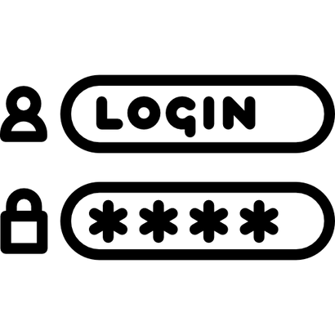
Communication Flow:
The Remote Desktop Application facilitates communication between the client and server components through a structured flow of interactions.
Connection Establishment:
The communication process begins with the client initiating a connection request to the server.
The client specifies the server's IP address and port number to establish a connection.
Upon receiving the connection request, the server creates a socket and accepts the connection from the client.
Authentication
Once the connection is established, the client is prompted to enter a password for authentication.
The client's password input is securely transmitted to the server for verification.
The server verifies the password and grants access to authenticated clients.
Screen Sharing:
The Remote Desktop Application follows a client-server architecture model.
In this model, the server component listens for incoming connections from clients, while clients initiate connections to servers.
This architecture enables centralized control of desktop interfaces, with multiple clients able to connect to a single server.
User Input Handling:
The client sends user input events, such as mouse clicks and keyboard inputs, to the server.
These user input events are encoded into command codes and transmitted to the server.
The server executes the received commands to simulate user interaction on the server's desktop interface.

Slide 5
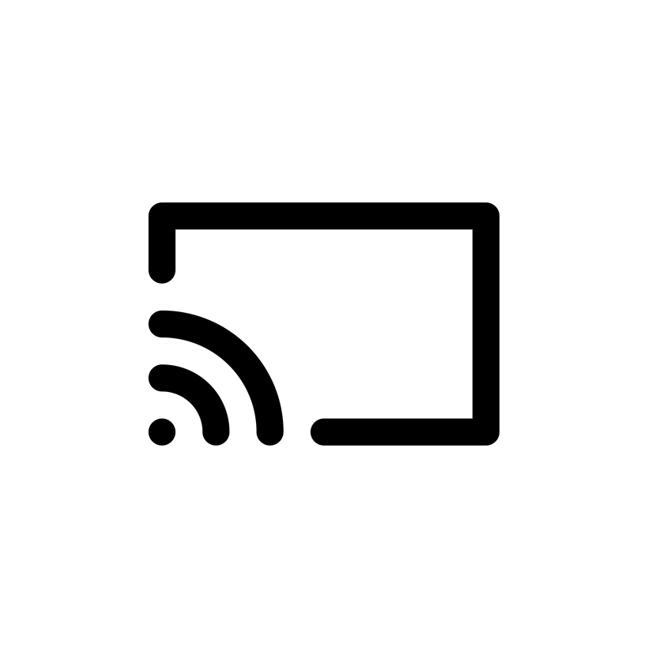
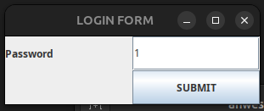
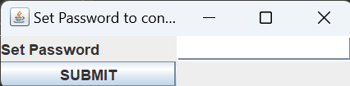
Features
The Remote Desktop Application offers a range of features designed to enhance remote desktop control, along with associated benefits for users.
Secure Authentication
The application ensures secure authentication through password verification, preventing unauthorized access to the server's desktop interface.
Real-time Screen Sharing:
Real-time screen sharing capabilities allow users to view the server's desktop interface remotely, enabling seamless collaboration and troubleshooting.
Seamless User Input Handling
The application efficiently handles user input events such as mouse clicks and keyboard inputs, ensuring responsive interaction with the server's desktop interface.

Slide 6
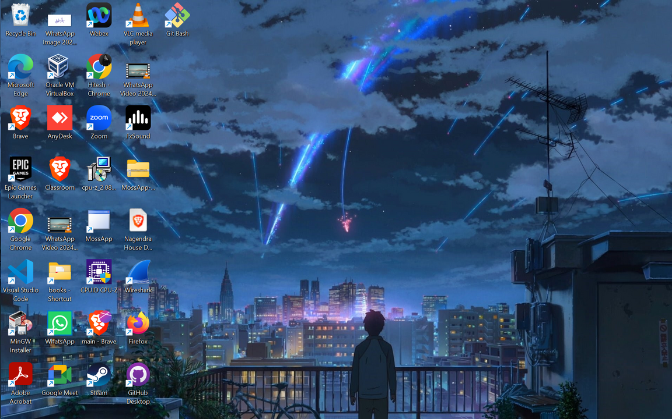
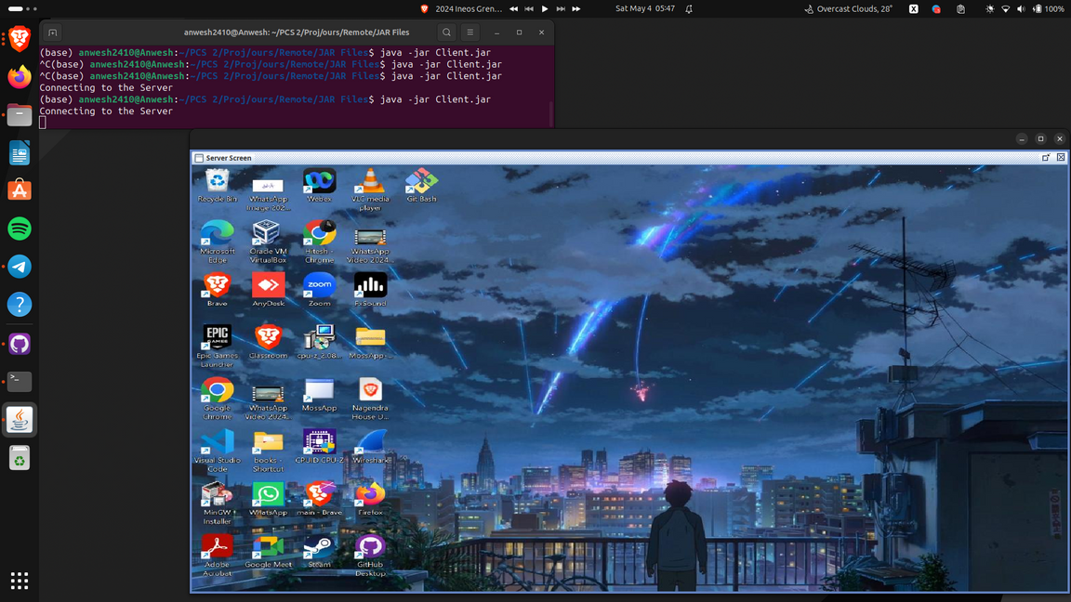
Demonstration
Server’s Screen
Client’s Screen

Slide 7

Benefits
Increased Productivity
By providing remote access to desktop interfaces, the application boosts productivity by allowing users to work from anywhere at any time.
Remote Troubleshooting
IT professionals can diagnose and resolve issues on remote computers without the need for physical presence, leading to faster problem resolution and minimized downtime.
Access to Resources
Users can access files, applications, and resources stored on remote computers, enabling efficient workflow management and resource utilization.
Collaboration
Teams can collaborate effectively by sharing screens and working together on projects in real-time, fostering communication and collaboration regardless of physical location.
Overall, the Remote Desktop Application offers a comprehensive set of features and benefits that cater to the diverse needs of users, enhancing productivity, collaboration, and efficiency in remote desktop control scenarios.

Slide 8


"Thank You"
-Hitesh , Anwesh

